Slide 1
Hacking 300 – Lesson 2
Windows Security Model and Domain Environments

Slide 2
Course Layout – Hacking 300
Lesson 1 – Introduction to Enterprise Networks Lesson 2 – Windows Domains and Active Directory Lesson 3 - Linux Networks
Lesson 4 – Kerberos Fundamentals
Lesson 5 – Attacking Domain Environments
Lesson 6 – CTF Start Lesson 7 – CTF Q&A
Lesson 8 – CTF Q&A Lesson 9 – CTF Q&A
Lesson 10 - Outbrief and Course Conclusion
← Today
Real-world systems: ethical hacking practicum – UW Summer 2021

Slide 3
Objectives
Understand the Windows security model
Accounts
Built-in accounts
Special account types
How credentials are stored
Groups
How they work
Built-in groups
Permissions
ACLs and ACEs
Different types of permissions throughout Windows

Slide 4
Objectives
Domains and AD (from attacker perspective)
What they are, how they are used
Key roles in a domain
Windows domain technologies - Active Directory, Group Policy
Domain security
User accounts, groups, permissions
Credential storage
How a workstation changes when it joins a domain
Authentication and authorization
Trusts
Policy settings

Slide 5
Windows Security Model – Accounts
Each user of the system (computer and/or domain) is assigned one or more accounts
Allows granting/restricting access to resources per account
Customized experiences/profiles per account
Roaming profiles (e.g: https://docs.microsoft.com/en-us/windows-server/storage/folder-redirection/deploy-roaming-user-profiles)
Accounts have one or more credentials for accessing the account
Password
PIN (Win10)
Smartcard
Biometrics and other less common providers
Notes:
- Windows user profile is a record of personal, user-specific data associated with a named user’s identity and desktop environment.
It contains many elements, such as settings, configuration items, connections and history.
Before Windows NT, there was no such thing as user profiles. Users who shared devices were accustomed to fighting with each other over configuration items, filenames, etc.
Windows NT and on user profiles stored in %systemdrive%\winnt\profiles
Windows 2000 moved profiles into a new folder, called %SYSTEMDRIVE%\Documents and Settings.
Roaming profile, lets user’s login to any machine on the corporate network. Windows maintains a profile for each user who logs into the OS. The employees data follows them from device to device.
When an employee logs in, Windows copies the user's profile from the organization's network share of profiles to the local computer. When the employee logs off, Windows copies any updates the user made to profile data from the desktop computer to the network copy of the profile.

Slide 6
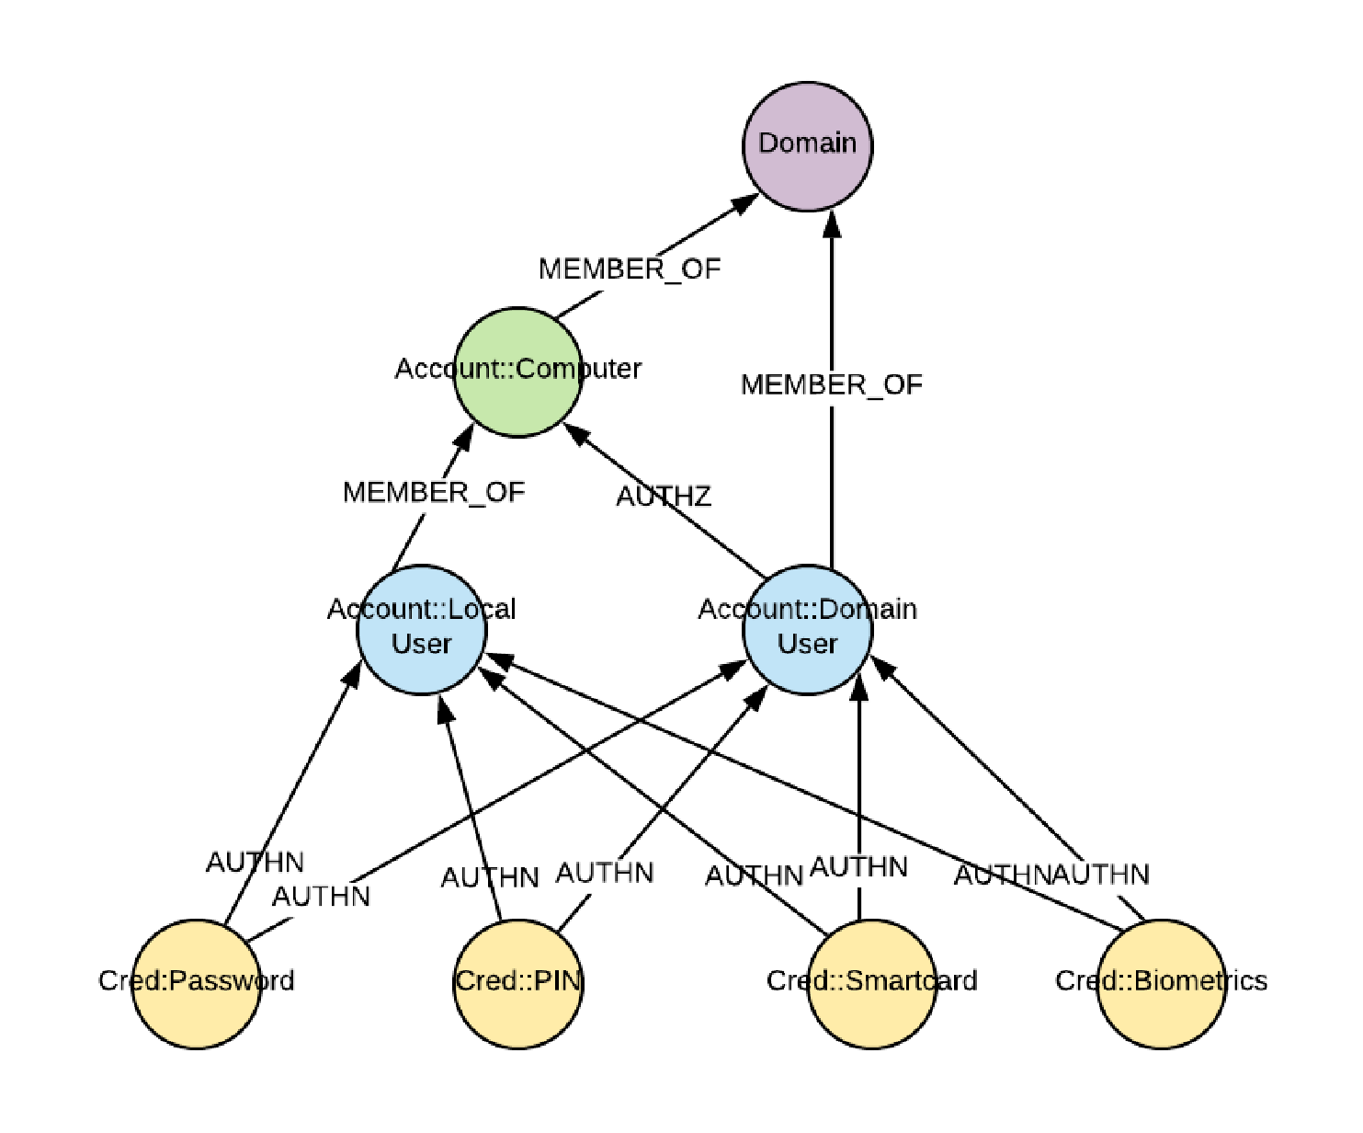
All diagrams are illustrative sketches only. You are encouraged to come up with your own ways to visualize
AD relationships!
Accounts and creds visualized
Notes:
Later we will walk together in building your very own tool to visual this kind of thing, a “pwn path”

Slide 7
Windows Security Model – Accounts
Built-in Accounts
Included by default in Windows
Local Admin (<Machine name>\Administrator)
Useful shortcut: On a domain-joined machine, force Windows to log you in as a local account with
.\Username
Guest (Hopefully disabled!)
NT AUTHORITY
Used to run services with different permission levels
Examples:
NT AUTHORITY\SYSTEM
NT AUTHORITY\Local Service
NT AUTHORITY\Network Service (see MSDN)
Notes:
LocalSystem account is a built-in Windows Account. It is the most powerful account on a Windows local instance, service account, not a user account.
It is recognized by the security subsystem, but it doesn't strictly exist as a user. It's a principle rather than a user. So we say “not recognised by security subsystem”.
subsystem keeps track of the security policies and the accounts that are on a computer system
exists to provide ownership to objects that are created before a normal user logs on, such as the Local Security Authority Subsystem (LSASS) and the Session Management Subsystem (SMSS).
Does not have a passwords, has evidence, which is a term used in the Windows security model to mean any form of identifying data that proves you are who you say you are. For example security tokens attached to threads or processes vs a actual password matching up to a profile.
LocalService account is a predefined local account used by the service control manager.
minimum privileges on the local computer and presents anonymous credentials on the network
account can be specified in a call to the CreateService and ChangeServiceConfig functions
account does not have a password
NetworkService account is a predefined local account used by the service control manager.
account is not recognized by the security subsystem
can be specified in a call to the CreateService and ChangeServiceConfig functions.
does not have a password
service that runs in the context of the NetworkService account presents the computer's credentials to remote servers. By default, the remote token contains SIDs for the Everyone and Authenticated Users groups.

Slide 8
Windows Security Model – Accounts
How are accounts/passwords stored?
Remember we talked about fgdump in Hacking 200?
Hashes are stored in the Windows SAM (Security Account Manager) file
Depending on Windows version, these are stored in different locations with different protections
C:\Windows\system32\config\SAM
HKEY_LOCAL_MACHINE\SAM
Notes:
The user passwords are stored in a hashed format in a registry hive either as a LM hash or as an NTLM hash. This file can be found in %SystemRoot%/system32/config/SAM and is mounted on HKLM/SAM.

Slide 9
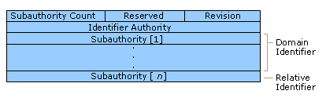
Windows Security Model – Accounts
Security Identifiers (SIDs)
Unique ID per account, at least “per system”
Most of the time, OS will use SID instead of the account name internally
Just like some accounts, some SIDs are “well known” and same on every machine
Authenticated Users – S-1-5-11
This is an alias for any user that has authenticated.
Can be used when granting permissions
Local System – S-1-5-18
… many more, full list on MSDN
E.g: “S-R-X-Y1-Y2-Yn-1-Yn”
S = Indicates that the string is a SID
R = Indicates the revision level
X = Indicates the identifier authority value
Y = series of subauthority values, where n is the number of values
Notes:
A security identifier (SID) is a data structure in binary format used to uniquely identify a security principal or security group.
fundamental building block of the Windows security model
works with specific components of authorization and access control and protects access to network resources and provides a more secure computing environment.
Security principals can represent any entity that can be authenticated by the operating system, such as a user account, a computer account, or a thread or process that runs in the security context of a user or computer account.
Each time a user signs in, the system creates an access token for that user.
The access token contains the user's SID, user rights, and the SIDs for any groups the user belongs to.
This token provides the security context for whatever actions the user performs on that computer.
In addition to the uniquely created, domain-specific SIDs that are assigned to specific users and groups, there are “well-known SIDs” that identify generic groups and generic users.
For example, the Everyone and World SIDs identify a group that includes all users. Well-known SIDs have values that remain constant across all operating systems.
---Table---
Revision: Indicates the version of the SID structure that is used in a particular SID.
Identifier authority: Identifies the highest level of authority that can issue SIDs for a particular type of security principal.
Subauthorities: most important information in a SID, which is contained in a series of one or more subauthority values.
Values up to, but not including, the last value identify a domain, called the domain identifier.
Last value in the series, which is called the relative identifier (RID), identifies a particular account or group relative to a domain
components of a SID are easier to visualize when SIDs are converted from a binary to a string

Slide 10
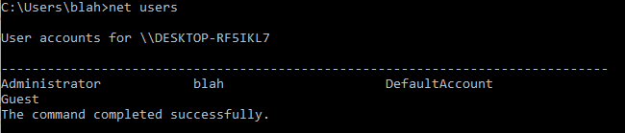
Windows Security Model – Accounts
What are some tools for enumerating users on a machine?
Command line: net users

Slide 11
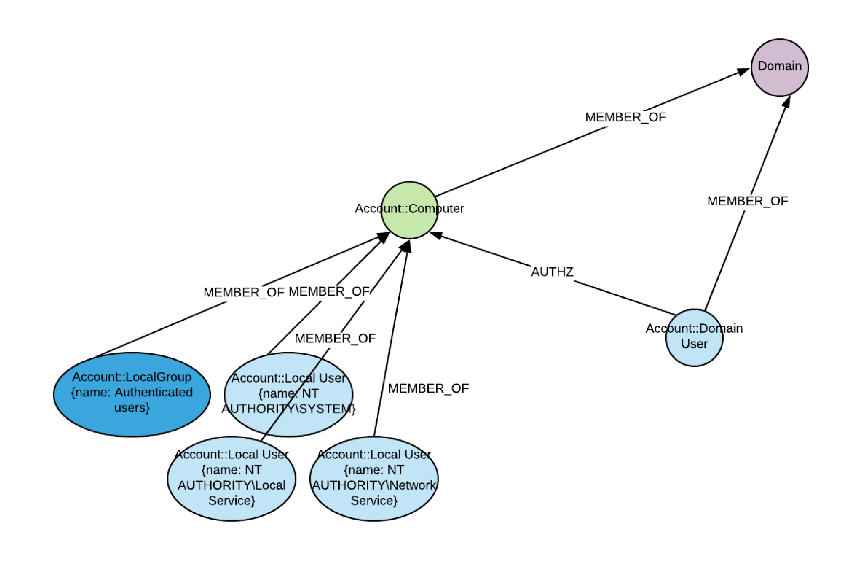
Some default users and groups visualized

Slide 12
Windows Security Model – Accounts
What are some tools for enumerating users on a machine?
GUI: Computer Management (compmgmt.msc) or Local Users and Groups (lusrmgr.msc) or Control Panel “User Accounts”
Note: on non-domain joined machine the .msc tools may not work depending on Windows version (they want you to use Control Panel)
Mmc – lets you manage remote machines in a domain too

Slide 13
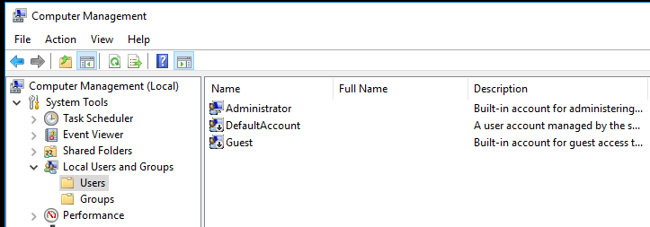

Slide 14
Windows Security Model – Groups
Groups can contain accounts, well known SID groups (“Authenticated Users”), and other groups
Simplifies permissions management (groups can be granted/denied permissions)
Built-in Groups
Administrators, Power Users, Users
Of course new groups can be created too.

Slide 15
Windows Security Model – Groups
Tools for interacting with groups
Command line: net group
GUI: Same as Users
Powershell

Slide 16
Windows Security Model - Permissions
Windows defines permissions using Access Control Lists (ACLs) and Access Control Entries (ACEs)
A resource's ACL contains the full list of permissions (ACEs) for that resource.
ACEs consist of:
SID
Access Mask - indicates the actual permissions
A flag for the type of ACE (Allow or Deny)
Some other flags indicating inheritance, etc.
Notes:
ACLs are applied against securable objects, such as files, folders, registry keys, and kernel objects.
Note: Keep in mind there are a bunch of undocumented objects in relation to ACLs
ACL is a list structure that can contain zero, one, or multiple ACE.
ACE describes a security identifier (SID) + specific access (or deny) rights allowed for that SID against a given object.
Two types of ACLs
discretionary access control list (DACL) - for controlling access to an object
system access control list (SACL) - for logging access attempts to an object

Slide 17
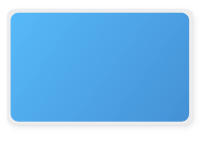
Windows Security Model - Permissions
ACE
S-1-5-11 (Authenticated Users)
Full Control
Allow
Child objects should inherit this ACE
Notes:
ACE describes a security identifier (SID) + specific access (or deny) rights allowed for that SID against a given object.

Slide 18
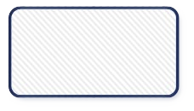
Windows Security Model - Permissions
ACL
ACE
S-1-5-11 (Authenticated Users)
Full Control
Allow
Child objects should inherit this ACE
Notes:
ACL is a list structure that can contain zero, one, or multiple ACE.

Slide 19
Windows Security Model - Permissions
ACL
ACE
S-1-5-11 (Authenticated Users)
Full Control
Allow
Child objects should inherit this ACE
ACE
S-1-5-7 (Anonymous)
Read/Write/Execute/Modify/...
Deny
Child objects should inherit this ACE
Notes:
ACL is a list structure that can contain zero, one, or multiple ACE.

Slide 20
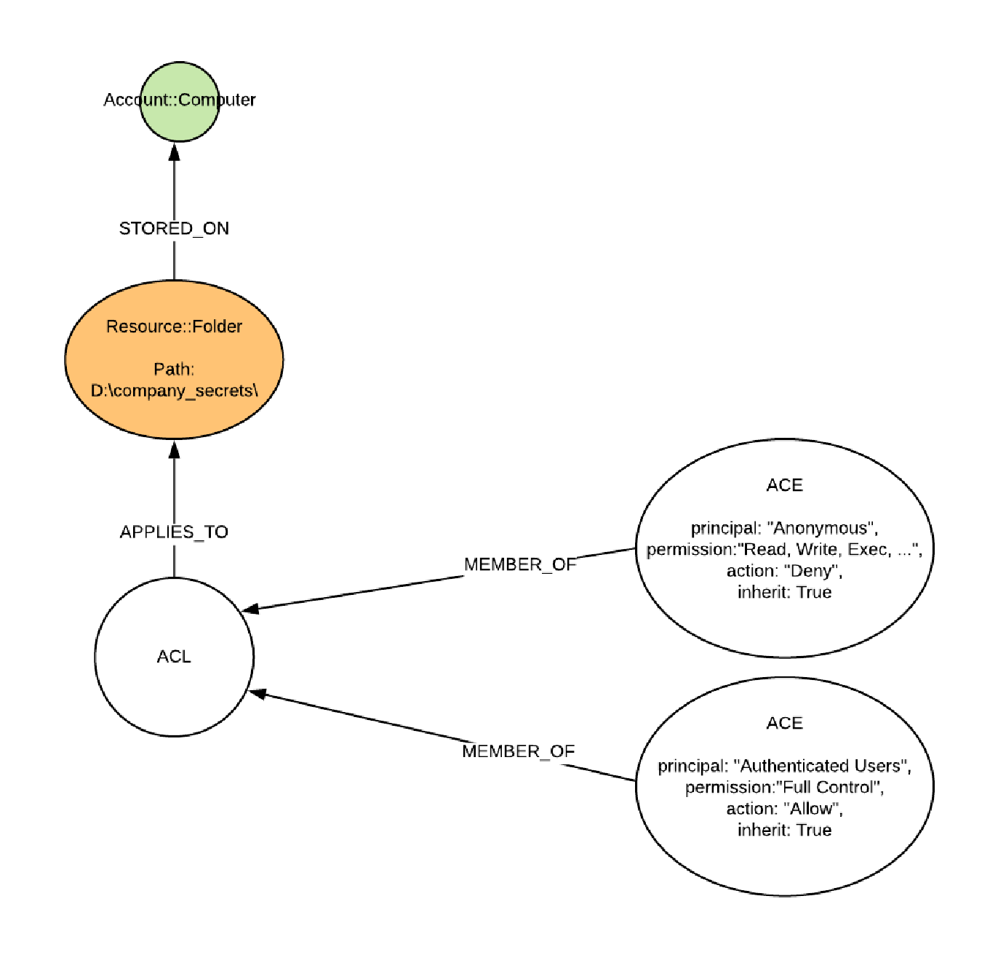
An exercise in evaluating permissions

Slide 21
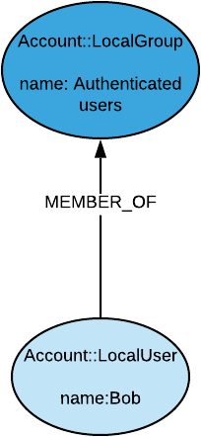
An exercise in evaluating permissions

Slide 22
An exercise in evaluating permissions

Slide 23
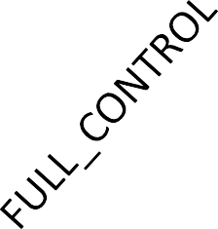
An exercise in evaluating permissions

Slide 24
How about for an anonymous user?

Slide 25
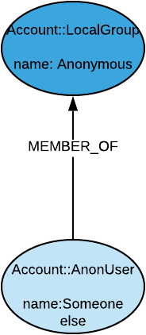
An exercise in evaluating permissions

Slide 26
An exercise in evaluating permissions

Slide 27
An exercise in evaluating permissions

Slide 28
Windows Security Model - Permissions
There are actually two kinds of ACLs
Discretionary (DACL) and System (SACL)
Most of the time when someone says “ACL” they probably mean DACL
SACLs define which accesses for the object end up generating an audit event
For example: generate an audit event when Anonymous fails to access this object
Notes:
discretionary access control list (DACL) - for controlling access to an object
system access control list (SACL) - for logging access attempts to an object

Slide 29
Windows Security Model - Permissions
The combined DACL, SACL, and owner information for an object are referred to as a Security Descriptor.
There is a special language for defining Security Descriptors: Security Descriptor Definition Language (SDDL)
This is what a DACL looks like in SDDL:
− D:AI(A;ID;FA;;;SY)(A;ID;FA;;;BA)(A;ID;FA;;;S-1-5-21-2301070057-449098063- 2537027615-1001)
You probably won't run into SDDL often, but it's good to know what it is if you do see it!

Slide 30
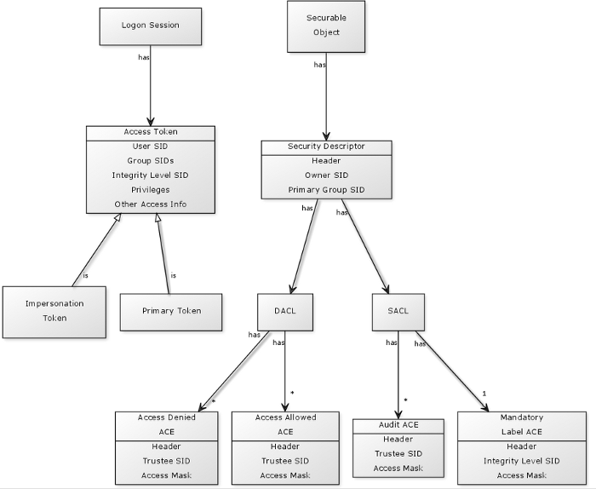
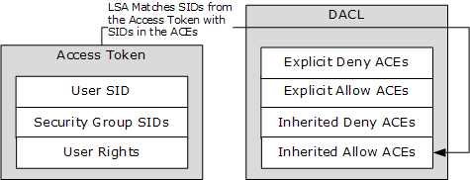
Windows Security Model - Permissions
Images from https://eneter.blogspot.com/2013/08/windows-security-wiki.html and https://winprotocoldoc.blob.core.windows.net/productionwindowsarchives/WinArchive/%5bMS-SECO%5d.pdf
Notes:
Images from https://eneter.blogspot.com/2013/08/windows-security-wiki.html and https://docs.microsoft.com/en-us/openspecs/windows_protocols/MS-WINPROTLP/df36f95e-6a6b-48d6-a3ae-35a17674f546?redirectedfrom=MSDN
Now tying everything together.
(left diagram) We see DACL has both Access Denied and Access Allowed ACEs
attempt is made to access a securable objects
system checks the ACEs specified in the object’s DACL to check whether access should be allowed or not
(right diagram) process is attempting to access a securable object
token is inspected and compared against ACE entries on the object’s DACL.
SIDs specified in the access token match those specified in the ACE, access is granted.

Slide 31
Windows Security Model - Permissions
Important: DENY entries override ALLOW entries
If there are two ACEs on an object and they are identical except one is ALLOW and one is DENY, the effective permissions will be DENY
If there are 20 different ACEs on an object granting a user ALLOW WRITE and one ACE DENYing them WRITE, what will the effective permissions be?
Notes:
It will be deny

Slide 32
Windows Security Model - Permissions
Tools for dealing with ACLs on File System
Command line
Cacls.exe (“See ACLs”)
Older/legacy tool, still useful sometimes though. On old versions of Windows it might be the only tool available.
icacls.exe (“I See ACLs”)
Newer version, similar behavior with more features.

Slide 33
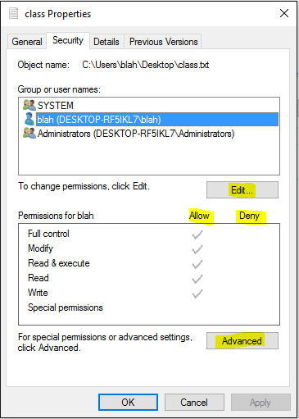
Windows Security Model - Permissions
UI
Right-click >> Properties
Security Tab

Slide 34
Windows Security Model - Permissions
ACLs aren't just for the File System though
Most objects in Windows use ACLs
Process Explorer from SysInternals can show you ACLs on a Process
Task Manager can too, but it's less detailed

Slide 35
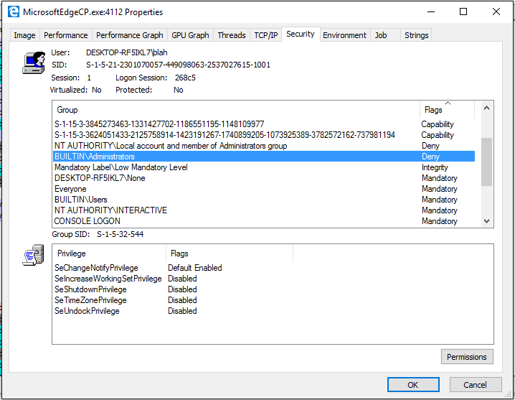
Windows Security Model - Permissions

Slide 36
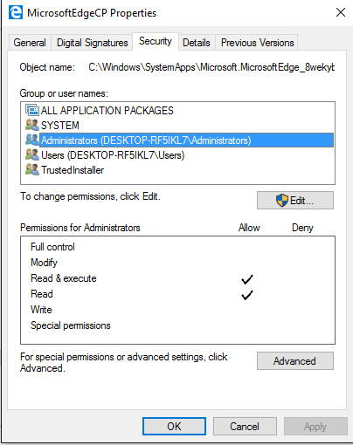
Windows Security Model - Permissions

Slide 37
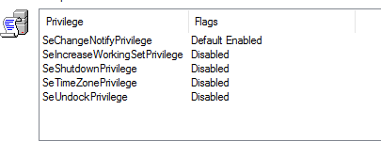
Windows Security Model - Permissions
Wait, what are these?

Slide 38
Windows Security Model - Permissions
Privileges
Separate mechanism from ACLs
Assigned to accounts or groups directly
ACLs are set on an object and the system checks a user's identity against the ACLs at access time
Privileges are granted to an account or group by an Administrator on the local machine or via domain policy

Slide 39
Windows Security Model - Permissions
Privileges allow various system level operations to be performed by a user
Examples:
SeSystemTimePrivilege
Change system time
Why is this a sensitive operation? Think about this before looking here.
SeShutdownPrivilege
Shutdown the machine
SeBackupPrivilege
Backup contents of a file, completely circumventing file system ACLs on the file

Slide 40
Windows Super Privileges
From Windows Internals Part One: 6th edition, page 546
SeDebugPrivilege
Open any process on system
Inject thread twith CreateRemoteThread to execute injected code in more-privileged security context
SeTakeOwnershipPrivilege
Take ownership by writing its own SID to owner field of object’s security descriptor
SeRestorePrivilege
Replace any file on system with your own
SeLoadDriverPrivilege
Load drivers
SeCreateTokenPrivilege
Generate tokens that represent arbitrary user accounts with arbitrary group membership

Slide 41
Windows Security Model - Permissions
How do we keep track of privileges for a user?
HKEY_LOCAL_MACHINE\SECURITY
Contains list of privileges for each SID
Protections on this location are similar to the SAM (security account manager)
When a user logs in, a token is created for the user describing their privileges
https://docs.microsoft.com/en-us/windows/win32/secauthz/access-tokens
When a user attempts an action requiring a privilege, the system checks the user's token for the presence of the privilege
Notes:
sam

Slide 42
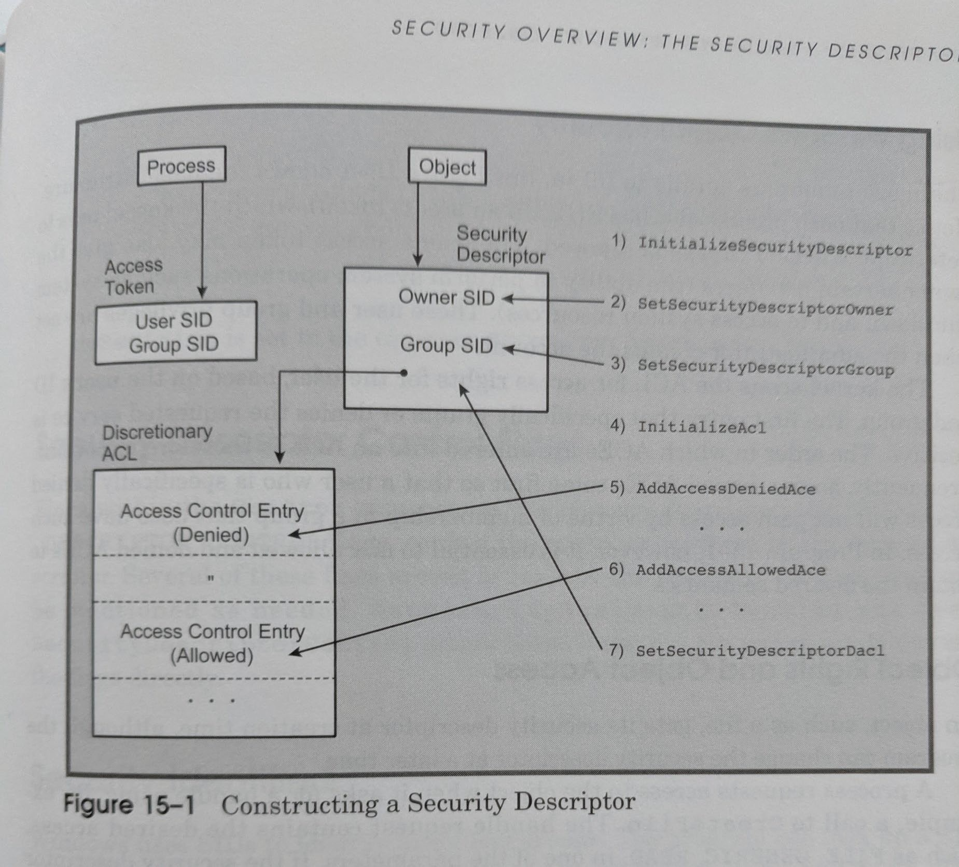
Windows System Programming Fourth Edition, Hart, 2010, page 521

Slide 43
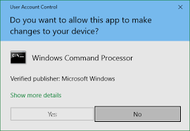
Windows Security Model - Permissions
You may have noticed before that the local Administrator account typically does not receive UAC dialogs, but other users in the Administrators group do...
Why is this?

Slide 44
Windows Security Model - Permissions
Local administrator account has a full token - all privileges listed in the token
Other admins have a split token - they are actually assigned two tokens
One token has all privileges filtered out
One token has all the privileges included
During normal use, the filtered token is used until you get a UAC prompt and hit 'Yes' – then the token with all privileges is checked to see if you really have the necessary privilege.
Notes:
A feature called "Session 0 Isolation" enhances security and protect the integrity of the installed OS
Earlier versions of the Windows operating system, all services run in the same session as the first user who logs on to the console, this session is called Session 0.
Running services and user applications together in Session 0 poses a security risk because services run at elevated privilege and therefore are targets for malicious agents who are looking for a means to elevate their own privilege level. (E.g: start up drivers, spools, etc. )
Normal user operations occurs using a different security token, “Session 1”, while all Administration functionality requires elevation into Session 0.
When operating as a Standard User, User Account Control will prompt for admin credentials when one of these administrative activities is triggered, and won't execute without this authentication.
Even as a Local Administrator, normal use occurs in Session 1 and elevation requests present a prompt (but no creds required).
UAC can be disabled, but it is not recommended.
This is all in an effort to ensure malware and viruses aren't sneaking around behind your back, elevating malicious processes without the user ever being notified.

Slide 45
Windows Security Model - Permissions
While pentesting, you probably won't deal directly with tokens
Unless you are writing a rootkit and patching Windows code
Understanding how privileges work is important though
You may compromise a process and need to check the privileges it has to fully understand what you can use it for!
Example
Compromise a back-end process on a server,
Find sensitive files, but don’t have read access
However, you notice the process' account has SeBackupPrivilege
From previous slide, what does this allow us to do?
We can run code from our compromised process to use system APIs as if we are a backup application
If you were only focused on ACLs, you would have missed this opportunity!

Slide 46
Windows Security Model
Any questions about what we've covered so far?

Slide 47
Windows Domains and Active Directory
In the last class, we briefly talked about LDAP
In a nutshell, Active Directory is a large LDAP database
containing resources, users, and computers
Organize a network’s assets in some logical structure
Centrally manage/configure/monitor those assets

Slide 48
Windows Domains and Active Directory
The outermost container in Active Directory is the forest
You can think of it as the “root” of AD
Its layout is basically a tree
Within a forest, an organization has one or more domains
Domains are a logical grouping of resources within the forest
Group resources by location, division, whatever you want.
Domains can be structured with parent/child relationships, just like “internet domains”
Example:
Washington.edu [Parent domain]
Compsci.Washington.edu [Child domain of Washington.edu]

Slide 49
Windows Domains and Active Directory
Within a domain, further logical organization can be done with Organizational Units (OUs)
E.g. Engineering Department OU, Network Equipment OU, All Workstations OU, any other arbitrary OU structure (up to organization)
Settings can be rolled out across the domain by OU
Permissions, software, machine configuration, etc.

Slide 50
Windows Domains and Active Directory
Forest
Parent Domain
Washington.edu
Child Domain
Child Domain
Compsci.Washington.edu
Business.Washington.edu
Workstations OU
Workstations OU
Labs OU

Slide 51
Active Directory trust relationships
Many types
One-way – Domain1 trusts Domain2 but not the other way around
Domain2 users can authenticate with Domain1
Two-way – Domain1 trusts Domain2, Domain2 trusts Domain1
Transitive
If Domain1 and Domain2 have a two-way trust,
And Domain2 and Domain3 have a two-way trust,
Then Domain1 and Domain3 can authenticate with each other
Nontransitive – Trust only applies to the two domains in a trust relationship
Trusts are important to understand pivoting between domains
There is a lot more complexity to trusts than we will cover here
Notes:
Trusts are the mechanism that ensures that a user who is authenticated in a domain can access resources in any trusted domain.
transitive trust is one in which the trust relationship that is extended to one domain is automatically extended to all other domains that trust that domain.
Nontransitive trusts are not automatic and must be set up. An example of a nontransitive trust is an external trust, such as the trust between a domain in one forest and a domain in another forest.

Slide 52
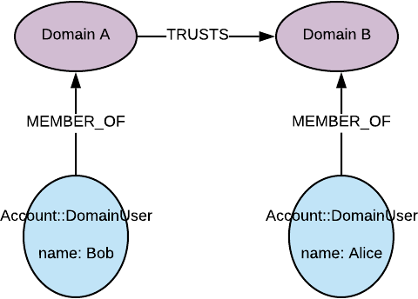
One-way trust

Slide 53
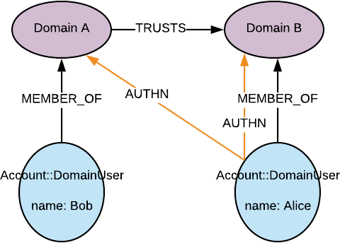
One-way trust

Slide 54
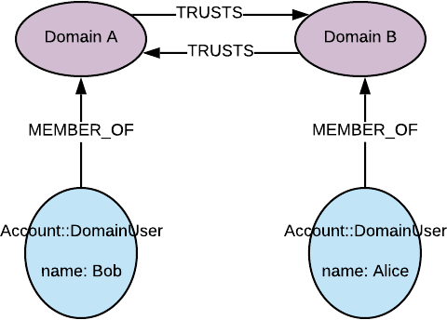
Two-way trust

Slide 55
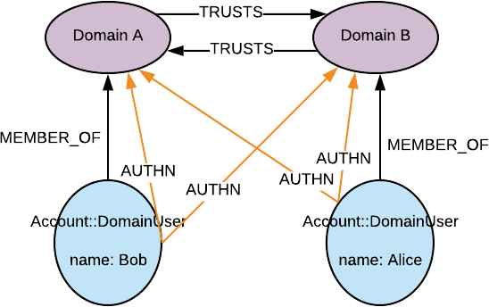
Two-way trust

Slide 56
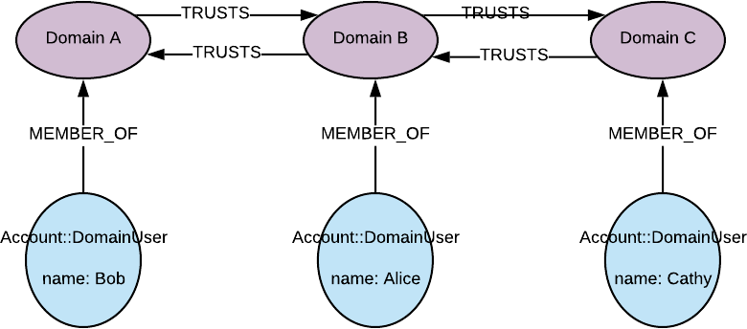
Transitive trusts

Slide 57
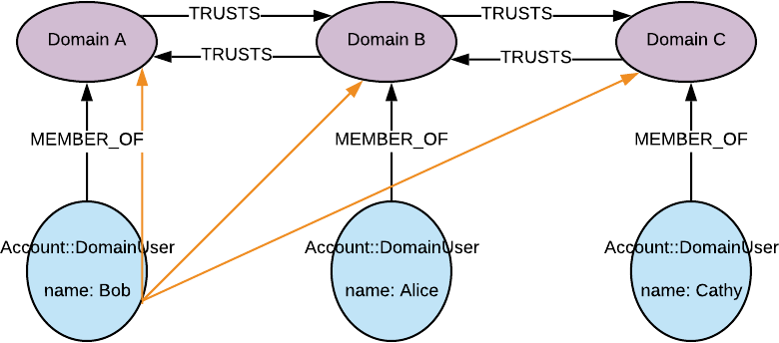
Transitive trusts

Slide 58
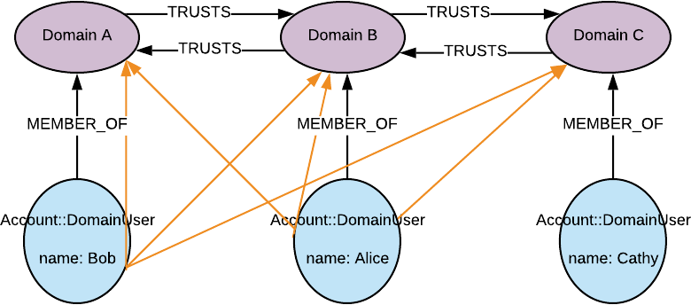
Transitive trusts

Slide 59
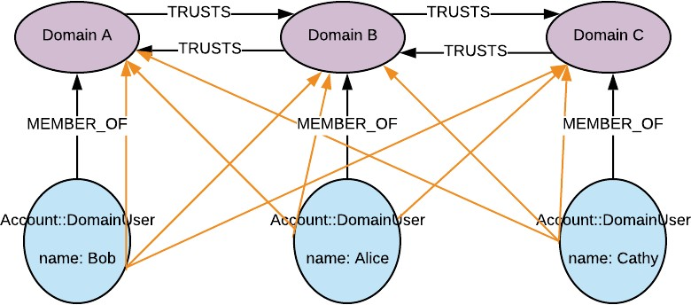
Transitive trusts

Slide 60
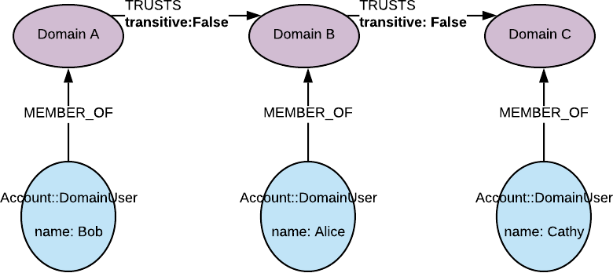
Non-transitive

Slide 61
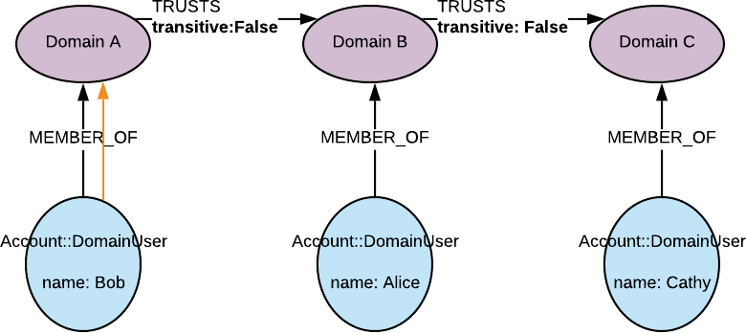
Non-transitive

Slide 62
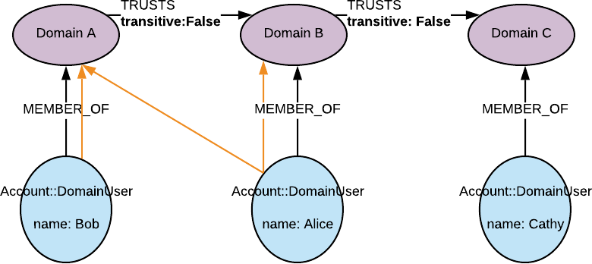
Non-transitive

Slide 63
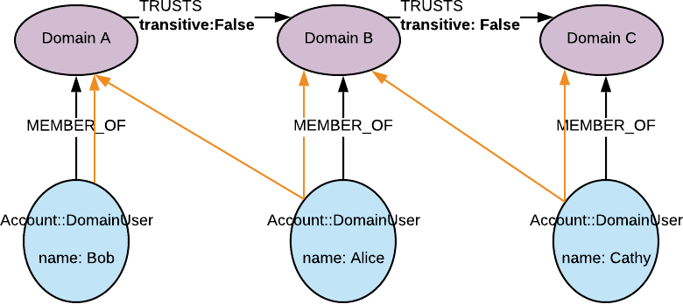
Non-transitive

Slide 64
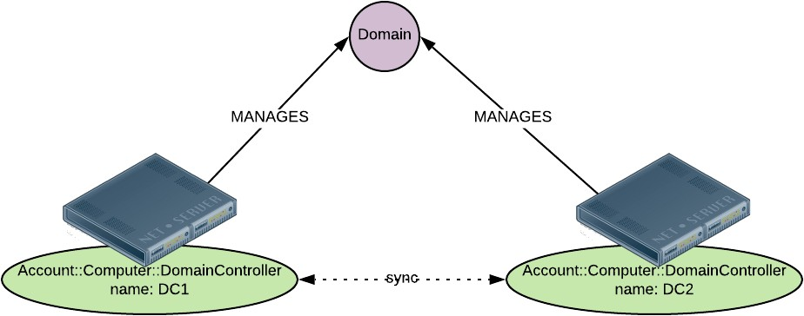
Windows Domains and Active Directory
Now we understand the basic “logical” structure of AD, what does the system actually look like?
Domain controllers are special servers in AD that keep copies of the entire directory/database
When the directory changes, DCs “replicate” the changes out to all other DCs to maintain consistency

Slide 65
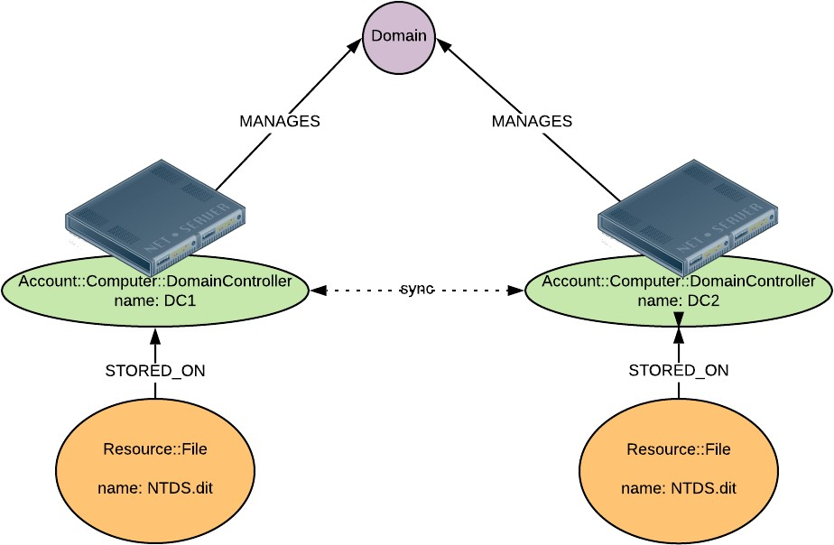
DCs manage authn and authz for the domain
DCs have password hashes/keys for every account in the domain (NTDS.DIT)
Valuable target for attackers

Slide 66
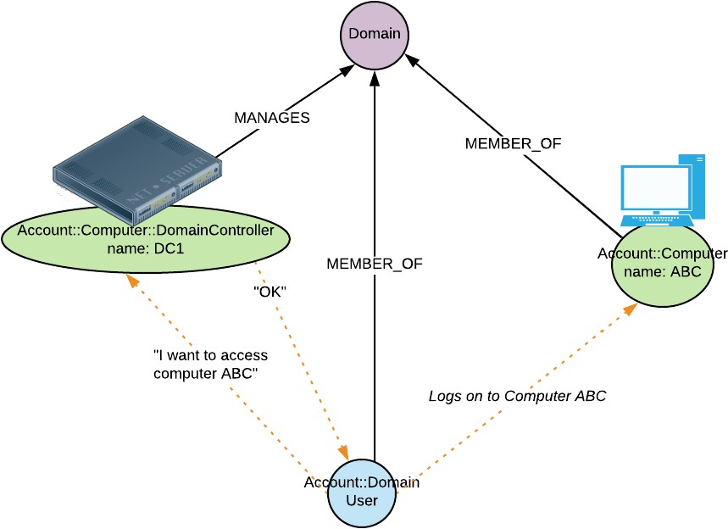
DCs manage authn and authz for the domain
When a user logs on to a domain-joined workstation, their login request goes to a DC which accepts or rejects the credentials

Slide 67
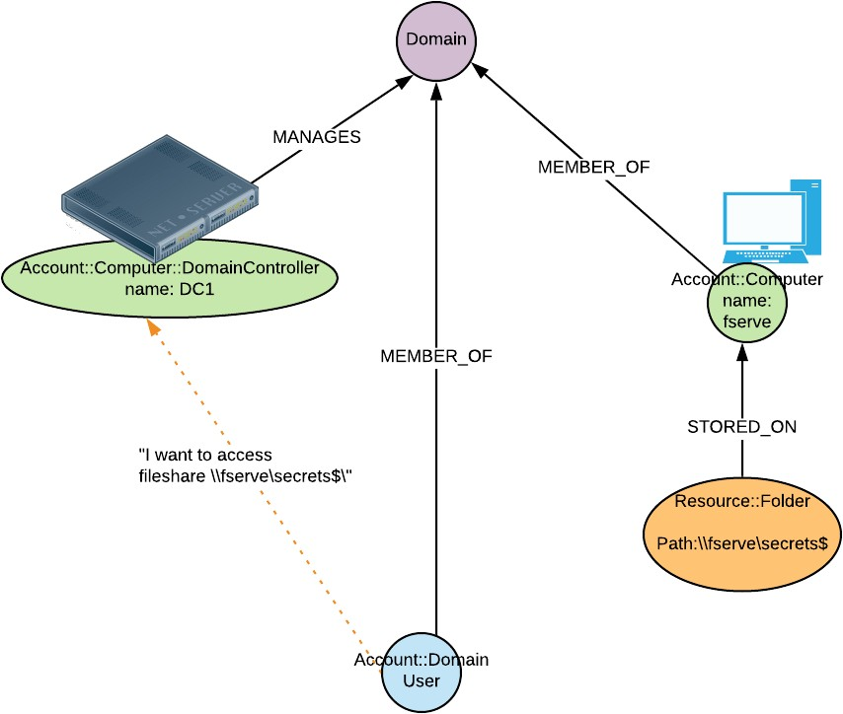
Same when accessing a file share, printer, or other resource.

Slide 68
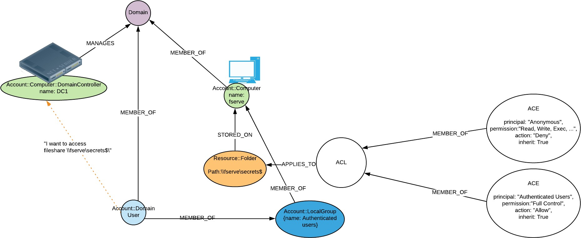
Same when accessing a file share, printer, or other resource.

Slide 69
Same when accessing a file share, printer, or other resource.
“OK”

Slide 70
Same when accessing a file share, printer, or other resource.
“OK”
Accesses the resource

Slide 71
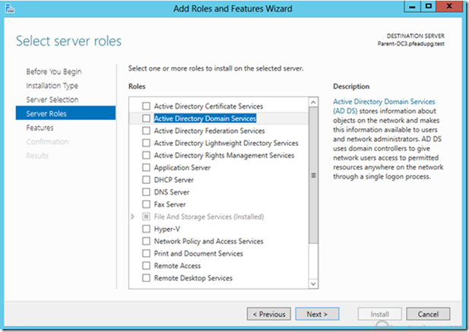
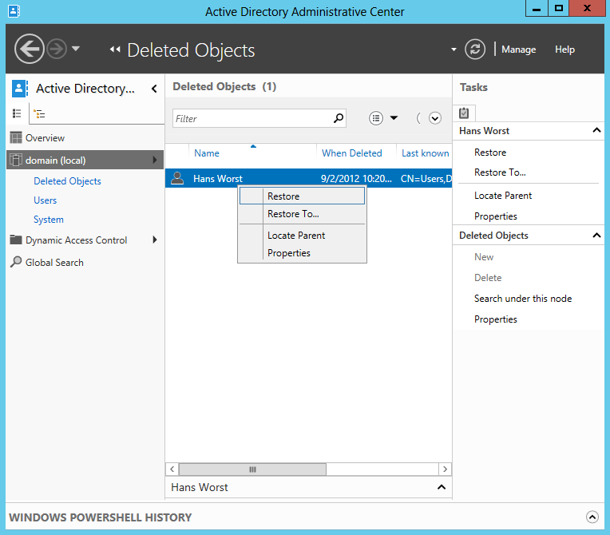
What does it physically look like?
It does a lot but looks like most window services

Slide 72
Windows Domains and Active Directory
AD uses Kerberos plus some Microsoft extensions for authentication/authorization in domains
This is often referred to as “Windows Authentication”
We will cover Kerberos in depth in a later module
Domains have their own set of Users and Groups
WASHINGTON\bob
WASHINGTON\Lab Administrators
Domains have a different set of Built-in Users and Groups
Domain administrator: WASHINGTON\Administrator
Domain Administrators group: WASHINGTON\Domain Admins
Domain Users group: WASHINGTON\Domain Users
By default every account created ends up a member of this group
Keep this in mind when you are securing resources or looking for weak ACLs
Many more…

Slide 73
Windows Domains and Active Directory
We previously talked about a local machine’s groups and accounts
What happens when a workstation joins a domain?
Local admin still exists, though policies can potentially disable it
Local groups may be populated with Domain users/groups
Local “Administrators” group may now contain WASHINGTON\bob, for example.
The computer itself has an account for use in the domain
WASHINGTON\LabServer1$ (computer name followed by $)
Randomly generated and automatically changed password
When services on the machine use the network, they will use this identity in many cases
Special case: when a server becomes a DC
Local admin goes away entirely for this machine. Only Domain Administrator (WASHINGTON\Administrator) exists afterwards.

Slide 74
Windows Domains and Active Directory
If the DCs maintain all the user/credential info but workstations can still have local users, does this change where we look for credentials?
Yes! Sort of…
Local accounts will still be in the SAM file (no change)
Domain accounts used on the workstation will have credential info cached in Local Security Authority (LSASS) process
Anyone who logs in locally
Potentially Remote Desktop sign-ins to the machine
Computer account credentials
Service accounts in use on the machine
Kerberos Tickets/Keys

Slide 75
Windows Domains and Active Directory
If you have Administrator rights on a workstation, you can attack lsass.exe and dump credential data from the workstation
This is a fundamental attack used to pivot throughout domain environments
Mimikatz is the most well-known tool for this kind of attack
We will cover this in-depth in a later module after we talk about Kerberos

Slide 76
Windows Domains and Active Directory
Group Policy
Mechanism within AD for rolling out configuration changes across the domain
Almost every setting in the Windows OS can be configured through GP
Users can be added, software installed
Allows administrators to maintain consistent configuration throughout their environment and easily change settings across the enterprise
Typically once a day or on first login, a domain joined workstation will check with the domain to make sure it has applied the current policies

Slide 77
Windows Domains and Active Directory
Group Policy security
Information gathering from policy
Once you compromise a domain joined machine, it may be worth looking through the policy settings on the machine to understand which security settings are turned on/off throughout the domain. Maybe:
All machines have a firewall configuration to allow a certain port
All machines get a scheduled task that runs a script from a file share every 4 hours
Maybe that script is writable and you can add your code to it?
Attacking GP itself
GP has a huge level of control over machines in the domain
Any tampering we can do with GP traffic or config has massive potential
Uses LDAP and SMB to roll out policy – we know these can have security problems
MITM attacks are possible here and have been demonstrated even in the last few years (MS15-014, MS15-011, MS17-010)
Sometimes shares containing GP policy files can contain clear text passwords (for example: when pushing a local account out to all machines)
If these aren’t locked down properly we may be able to steal powerful credentials

Slide 78
Windows Domains and Active Directory
More important services in a domain
DNS – Without secured and reliable DNS, domains fall apart
Kerberos, the underlying auth mechanism, requires trusted DNS
Yes, this can be a problem!
DHCP
Email
MSSQL DB

Slide 79
Windows Domains and Active Directory
Common domain security problems
Too many administrators
Trusts with other domains that are insecure
Default accounts (Local admin, guest)
Overlooked/forgotten policies or misconfiguration
Legacy/backwards compatibility features
LM/NTLM
DCs being backed up insecurely or to insecure locations, no encryption
Remember: they have *all* the creds!
Even if you change every password on every account, there are keys on a DC that almost never change but allow complete compromise of the domain
Unencrypted traffic

Slide 80
Windows Domains and Active Directory
Domain controller compromise is game over
Recovery can be expensive and disruptive
We will talk more about specifics in Kerberos and Mimikatz modules
DCs must be protected at all costs
Single point(s) of failure

Slide 81
Windows Domains and Active Directory
Questions?

